Slide 1
Honors Geometry
Sec 3.1: Parallel Lines and Transversals

Slide 2
Learning Target & Standards
After this section you will have completed the following Common Core State Standard(s):
G.CO.1: Know precise definitions of angle, circle, perpendicular and parallel lines and line segments based on the undefined notions of point, line distance along line/around an arc, etc.
And will be improving your skills in the following Mathematical Practice(s):
1. Make sense of problems and persevere in solving them
3. Construct viable arguments and critique the reasoning of others

Slide 3
Learning Target & Standards
Specifically, you should be able to:
Identify the relationship between 2 lines or 2 planes
Name angle pairs formed by lines and transversals

Slide 4
Vocabulary
Parallel Lines:
Coplanar lines that do not intersect

Slide 5
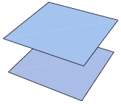
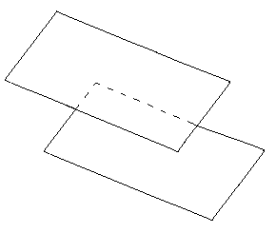
Vocabulary
Parallel Planes:
Planes that do not intersect

Slide 6
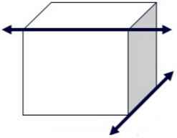
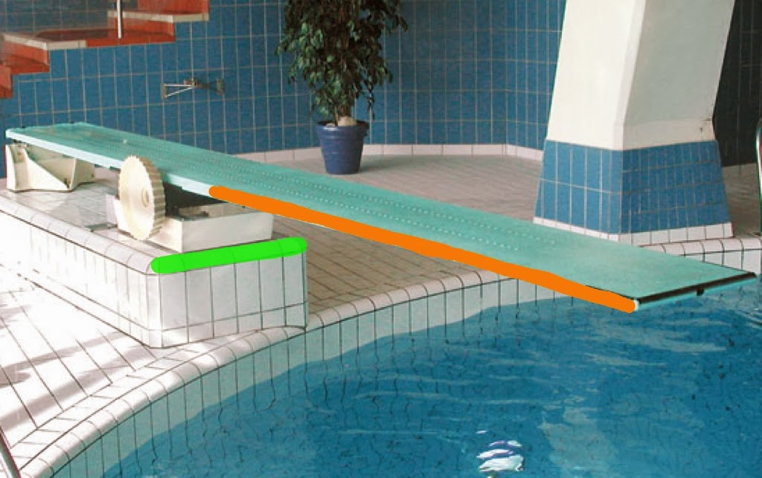
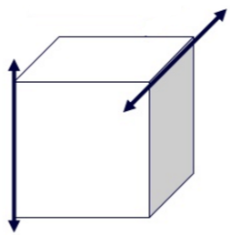
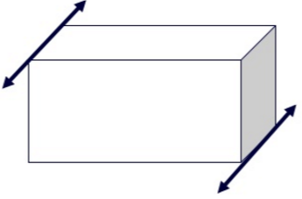
Vocabulary
Lines that do NOT intersect and are NOT coplanar
Skew Lines:
←Skew→
↓
Not Skew →

Slide 7
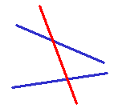
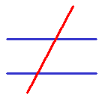
Vocabulary
Transversal:
A line that intersects at least 2 other coplanar lines at different points

Slide 8
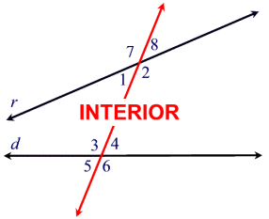
Vocabulary
Angles that lie
Interior Angles:
in the region between two lines
Angles 1, 2, 3 & 4 are inside the 2 lines and therefore are interior angles.

Slide 9
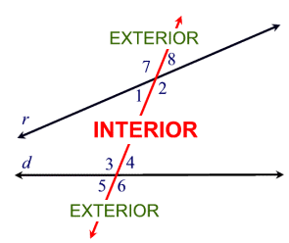
Vocabulary
Angles that lie
Exterior Angles:
in the region not between two lines
Angles 5, 6, 7 & 8are outside the 2 lines and therefore are exterior angles.

Slide 10
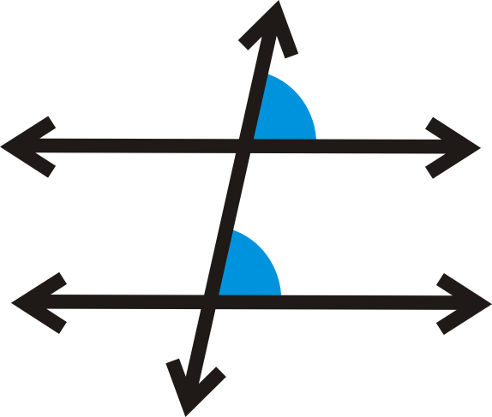
Vocabulary
Corresponding Angles:
Angles that lie on the same side of the transversal and the same side of each if the respective lines.

Slide 11
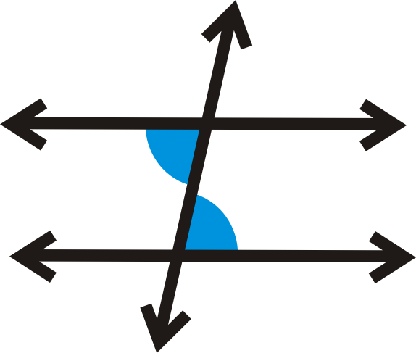
Vocabulary
Alternate Interior Angles:
Non-adjacent interior angles that lie on the opposite sides of the transversal.

Slide 12
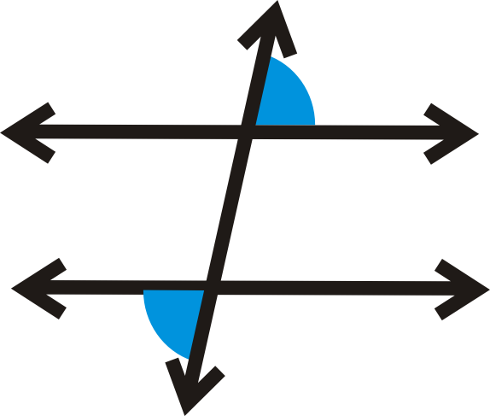
Vocabulary
Alternate Exterior Angles:
Non-adjacent exterior angles that lie on the opposite sides of the transversal.

Slide 13
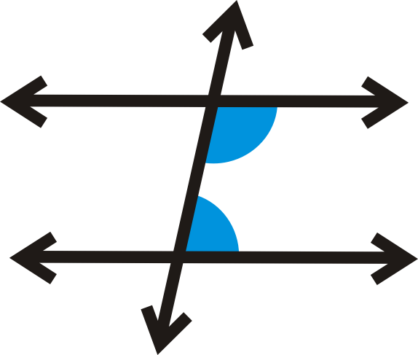
Vocabulary
Consecutive Interior Angles:
Interior angles that lie on the same side of the transversal.

