Slide 1
Honors Geometry
Sec 3.2: Angles and Parallel Lines

Slide 2
Learning Target & Standards
After this section you will have completed the following Common Core State Standard(s):
G.CO.1: Know precise definitions of angle, circle, perpendicular and parallel lines and line segments based on the undefined notions of point, line distance along line/around an arc, etc.
And will be improving your skills in the following Mathematical Practice(s):
1. Make sense of problems and persevere in solving them
3. Construct viable arguments and critique the reasoning of others

Slide 3
Learning Target & Standards
Specifically, you should be able to:
Use theorems to determine the relationships between specific angle pairs
Use algebra to find angle measures

Slide 4
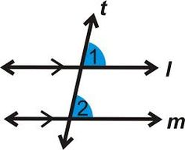
Postulates & Theorems
Corresponding Angles Postulate:
If 2 PARALLEL lines are cut by a TRANSVERSAL, then the corresponding angles are CONGRUENT.

Slide 5
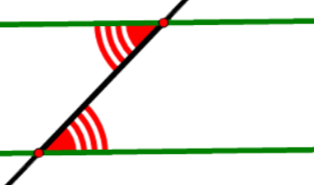
Postulates & Theorems
Alternate Interior Angles Theorem:
If 2 PARALLEL lines are cut by a TRANSVERSAL, then the alternate interior angles are CONGRUENT.

Slide 6
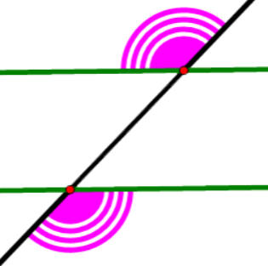
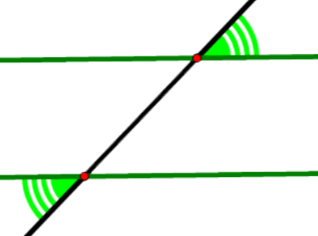
Postulates & Theorems
Alternate Exterior Angles Theorem:
If 2 PARALLEL lines are cut by a TRANSVERSAL, then the alternate exterior angles are CONGRUENT.

Slide 7
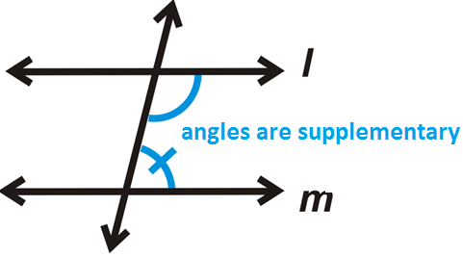
Postulates & Theorems
Consecutive Interior Angles Theorem:
If 2 PARALLEL lines are cut by a TRANSVERSAL, then the consecutive interior angles are SUPPLEMENTARY.

Slide 8
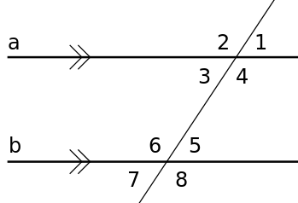
Try It Out #1
Use the corresponding angles postulate to answer the following:
If a || b, then—

Slide 9
Try It Out #1 Answer
Use the corresponding angles postulate to answer the following:
If a || b, then—
∠1 ≅ ∠5 ∠2 ≅ ∠6
∠3 ≅ ∠7 ∠4 ≅ ∠8

Slide 10
Try It Out #2
Use the alternate interior angles theorem to answer the following:
If a || b, then—

Slide 11
Try It Out #2 Answer
Use the alternate interior angles theorem to answer the following:
If a || b, then—
∠3 ≅ ∠5 ∠4 ≅ ∠6

Slide 12
Try It Out #3
Use the alternate exterior angles theorem to answer the following:
If a || b, then—

Slide 13
Try It Out #3 Answer
Use the alternate interior angles theorem to answer the following:
If a || b, then—
∠2 ≅ ∠8 ∠1 ≅ ∠7

Slide 14
Try It Out #4
Use the consecutive interior angles theorem to answer the following:
If a || b, then—

Slide 15
Try It Out #4 Answer
Use the consecutive interior angles theorem to answer the following:
If a || b, then—
∠3 supp ∠6
∠4 supp ∠5

