Slide 1
Honors Geometry
Sec 3.3 – 4: Slopes and Equations of Lines

Slide 2
Learning Target & Standards
After this section you will have completed the following Common Core State Standard(s):
G.GPE.5: Prove the slope criteria for parallel and perpendicular and use them to solve geometric problems
And will be improving your skills in the following Mathematical Practice(s):
4. Model with mathematics
7. Look for and make use of structure
8. Look for and express regularity in repeated reasoning

Slide 3
Learning Target & Standards
Specifically, you should be able to:
Find slopes of lines and use it to identify parallel and perpendicular lines
Write equations of lines given information about the graph
Solve problems by writing equations

Slide 4
Recall from Algebra…
Slope = the measure of how steep a line/ line segment is, given by the equations:

Slide 5

Recall from Algebra…
Slope $=$ $\frac{y_{2}−y_{1}}{x_{2}−x_{1}}=\frac{∆y}{∆x}=\frac{rise }{run}$

Slide 6
Recall from Algebra…
Slopes (and comparing slopes) of lines gives you information about the lines and their relationship to other lines

Slide 7
Recall from Algebra…
Lines that are PARALLEL slant in the same direction, so the have the SAME slopes
Lines that are PERPENDICULAR have OPPOSITE RECIPROCAL slopes

Slide 8
Recall from Algebra…
Horizontal lines have a slope of ZERO.
Vertical Lines have UNDEFINED SLOPES.
Vertical and Horizontal lines are always PERPENDICULAR.

Slide 9
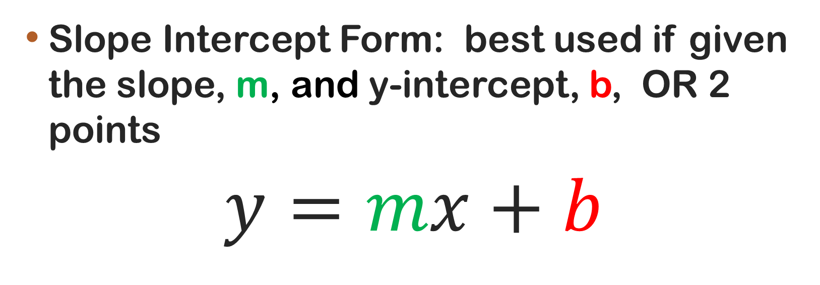
Equations of Lines
Slope Intercept Form: best used if given the slope, m, and y-intercept, b, OR 2 points
$$y=mx+b$$

Slide 10
Example: Slope Intercept
Given (2, -3) and (5, 6), write the slope intercept form of the line that passes through the 2 points.

Slide 11
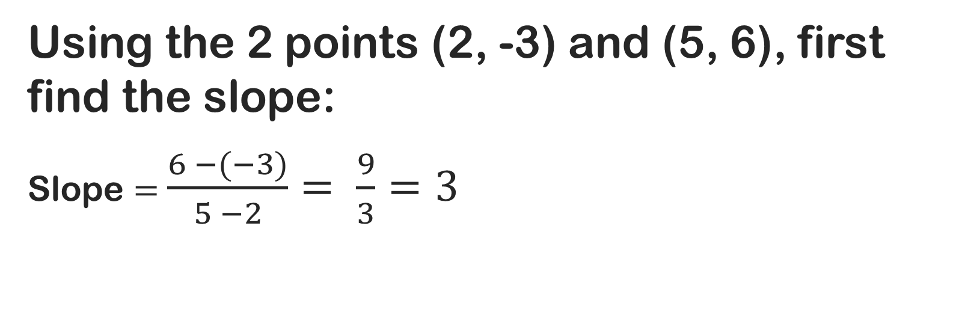
Example: Slope Intercept
Using the 2 points (2, -3) and (5, 6), first find the slope:
Slope $=$ $\frac{6 −(−3)}{5 −2}= \frac{9}{3}=3$

Slide 12
Example: Slope Intercept
Using the slope and 1 of the points, solve for b (y-intercept):
y = mx + b where m = 3 and (2,-3) is a pt on line
-3 = 3(2) + b substitute m and pt
-3 = 6 + b simplify/ multiply
b = -9 solve for b

Slide 13
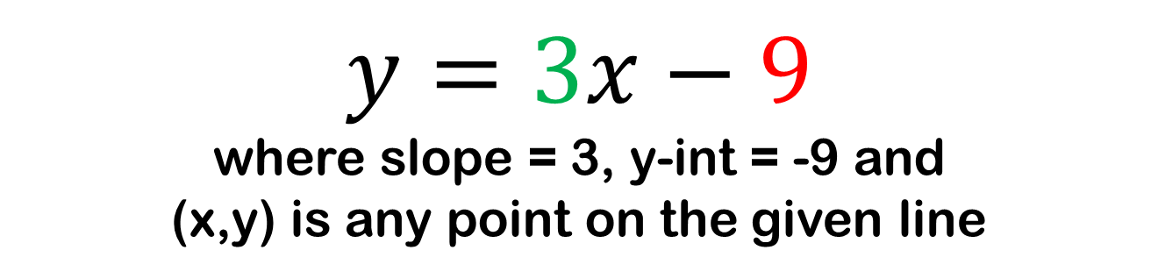
Example: Slope Intercept
Given (2, -3) and (5, 6), write the slope intercept form of the line that passes through the 2 points.
$$y=3x−9$$
where slope = 3, y-int = -9 and
(x,y) is any point on the given line

Slide 14
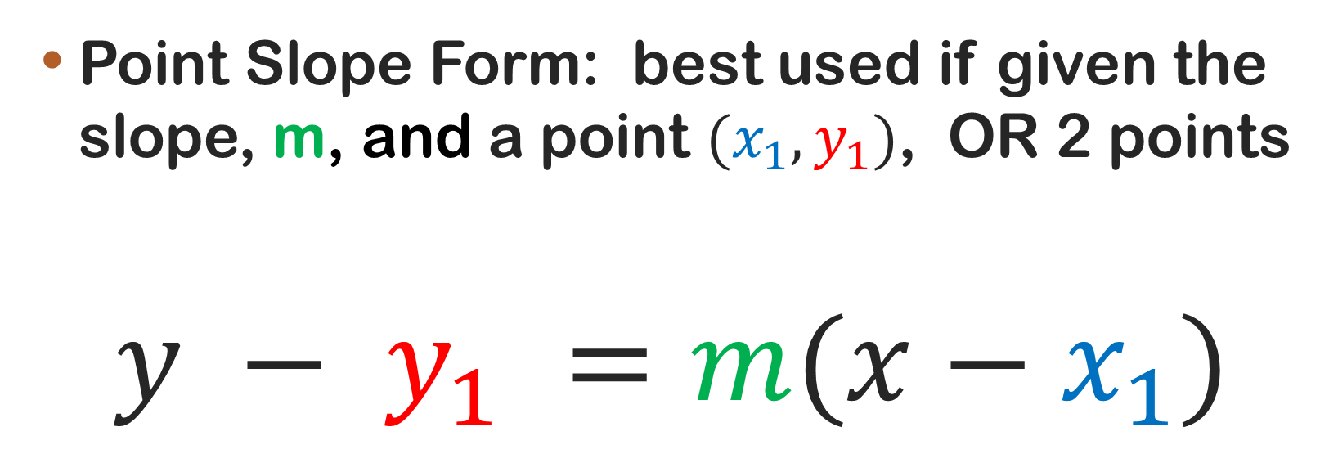
Equations of Lines
Point Slope Form: best used if given the slope, m, and a point $(x_{1}, y_{1})$, OR 2 points
$$y − y_{1} =m(x−x_{1})$$

Slide 15
Example: Point Slope
Given (2, -3) and (5, 6), write the point slope form of the line that passes through the 2 points.

Slide 16
Example: Point Slope
Using the 2 points (2, -3) and (5, 6), first find the slope:
Slope $=$ $\frac{6 −(−3)}{5 −2}= \frac{9}{3}=3$

Slide 17
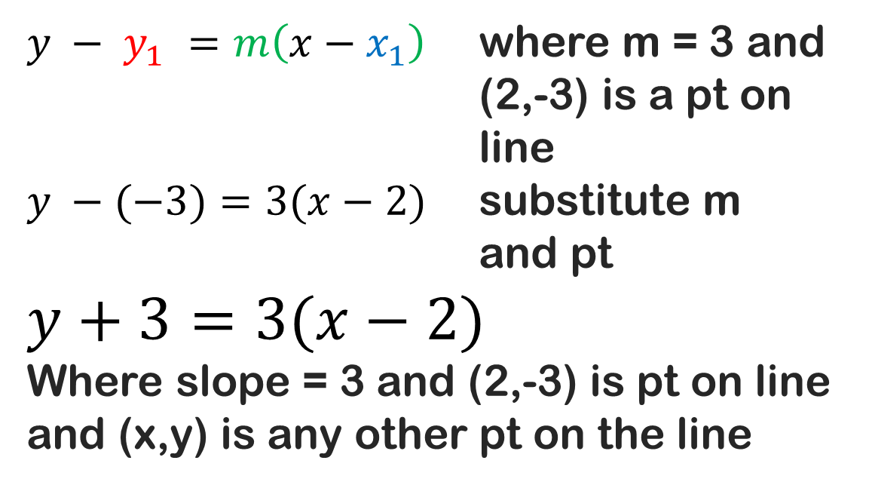
Example: Point Slope
Using the slope and 1 of the points, fill in the parts of the equation:
$y − y_{1} =m\left(x−x_{1}\right)$ where m = 3 and (2,-3) is a pt on line
$y −(−3)=3(x−2)$ substitute m and pt
$$y+3=3(x−2)$$
Where slope = 3 and (2,-3) is pt on line and (x,y) is any other pt on the line

Slide 18
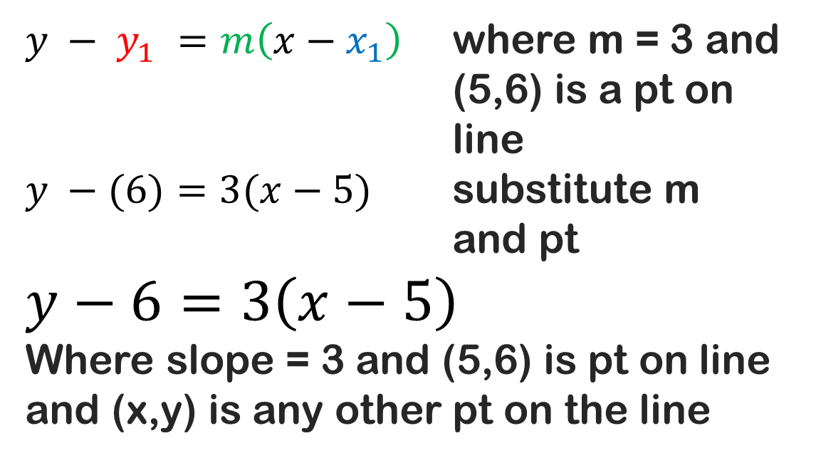
Example: Point Slope
Using the slope and the OTHER point, fill in the parts of the equation:
$y − y_{1} =m\left(x−x_{1}\right)$ where m = 3 and (5,6) is a pt on line
$y −(6)=3(x−5)$ substitute m and pt
$$y−6=3\left(x−5\right)$$
Where slope = 3 and (5,6) is pt on line and (x,y) is any other pt on the line

