Slide 1
Honors Geometry
Sec 3.5: Proving Lines Parallel

Slide 2
Learning Target & Standards
After this section you will have completed the following Common Core State Standard(s):
G.CO.9: Prove theorems about lines and angles
And will be improving your skills in the following Mathematical Practice(s):
1. Make sense of problems and persevere in solving them
3. Construct viable arguments and critique the reasoning of others

Slide 3
Learning Target & Standards
Specifically, you should be able to:
Recognize angle pairs that occur with parallel lines
Prove that 2 lines are parallel

Slide 4
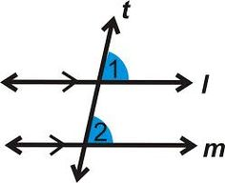
Postulates & Theorems
Converse of Corresponding Angles Postulate:
If 2 lines are cut by a TRANSVERSAL so that the corresponding angles are CONGRUENT, then the lines are PARALLEL.

Slide 5
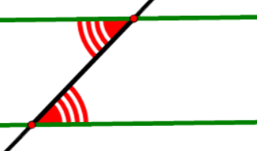
Postulates & Theorems
Converse of Alternate Interior Angles Theorem:
If 2 lines are cut by a TRANSVERSAL so that the alternate interior angles are CONGRUENT, then the lines are PARALLEL.

Slide 6
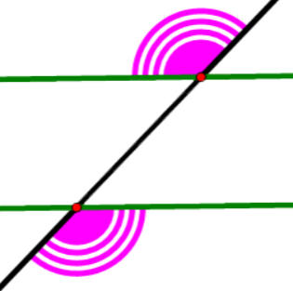
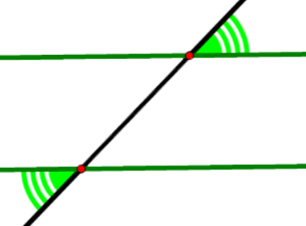
Postulates & Theorems
Converse of Alternate Exterior Angles Theorem:
If 2 lines are cut by a TRANSVERSAL so that the alternate exterior angles are CONGRUENT, then the lines are PARALLEL.

Slide 7
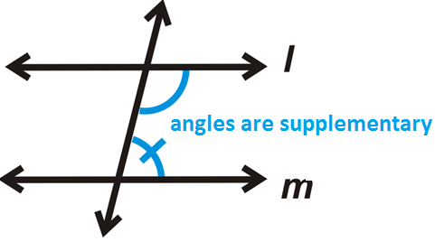
Postulates & Theorems
Converse of Consecutive Interior Angles Theorem:
If 2 lines are cut by a TRANSVERSAL so that the consecutive interior angles are SUPPLEMENTARY then the lines are PARALLEL

Slide 8
Postulates & Theorems
What is the difference between the past 4 “converse” theorems/ postulates and their original theorems/ postulates from Sec 3.2?

Slide 9
Postulates & Theorems
What is the difference between the past 4 “converse” theorems/ postulates and their original theorems/ postulates from Sec 3.2?
In the original theorems/postulates, if parallel lines are given, then you are PROVING that angles are congruent/supplementary. In the converses, if you are given the angle relationships, then you are PROVING that lines are parallel.

Slide 10
Postulates & Theorems
If 2 lines are parallel to the same line then they are parallel to each other

Slide 11
Postulates & Theorems
If 2 lines are parallel to the same line then they are parallel to each other

Slide 12
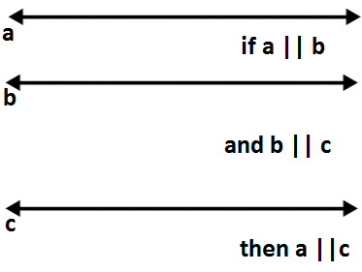
Postulates & Theorems
If 2 lines are parallel to the same line then they are parallel to each other

Slide 13
Postulates & Theorems
If 2 lines are parallel to the same line then they are parallel to each other

Slide 14
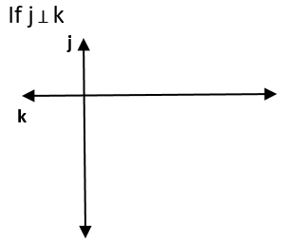
Postulates & Theorems
If 2 lines are perpendicular to the same line then they are parallel to each other

Slide 15
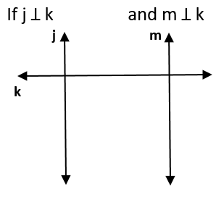
Postulates & Theorems
If 2 lines are perpendicular to the same line then they are parallel to each other

Slide 16
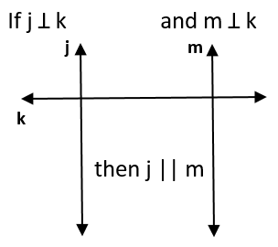
Postulates & Theorems
If 2 lines are perpendicular to the same line then they are parallel to each other

Slide 17
Postulates & Theorems
Parallel Postulate: Given a line and a point not on the line, there is exactly one line through the point that is parallel to the given line.

