Slide 1
Honors Geometry
Sec 3.6: Perpendiculars and Distance

Slide 2
Learning Target & Standards
After this section you will have completed the following Common Core State Standard(s):
G.MG.3: Apply geometric methods to solve problems
And will be improving your skills in the following Mathematical Practice(s):
2. Reason abstractly and quantitatively
4. Model with mathematics

Slide 3
Learning Target & Standards
Specifically, you should be able to:
Find the distance between a point and a line
Find the distance between parallel lines

Slide 4
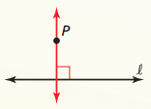
Postulates & Theorems
Perpendicular Postulate: Given a line and a point not on the line, there is exactly one line through the point that is perpendicular to the given line.

Slide 5
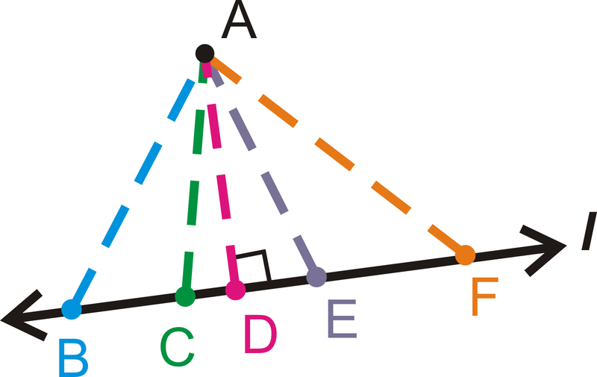
Postulates & Theorems
The distance from a point to a line is the length of the segment perpendicular to the line from the point.
AD = distance from A to line l

Slide 6
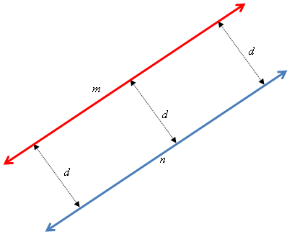
Postulates & Theorems
The distance between parallel lines is the perpendicular distance one of the lines and any point on the other line

Slide 7
Vocabulary
Equidistance of parallel lines:
Distance between measured along a perpendicular line to both parallel lines is constant.

